Slide 1
Servlets and JDBC

Slide 2
Servlets and JDBC
Servlets can connect to Database like normal Java programs.
Database Connections are costly resources and if not managed properly will cause performance problems.
Create connection objects in init() and close them in destroy().
But then, you must be implementing SingleThreadModel interface.
The remedy to the situation is creating a pool of database connections.

Slide 3
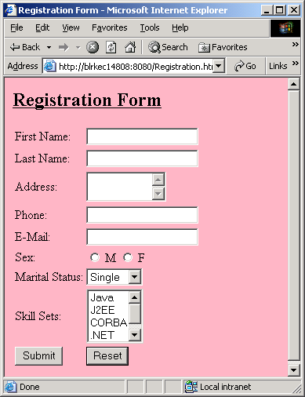
Example - Registration

Slide 4
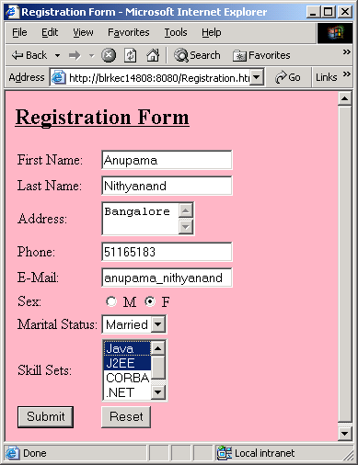
Example - Registration…

Slide 5
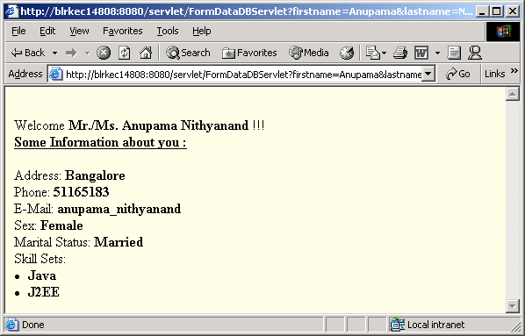
Example - Registration…

Slide 6
Registration Example - Code

Slide 7
Registration.html
<html>
<head>
<title> Registration Form </title>
</head>
<body bgcolor=lightpink>
<form action=
"http://blrkec14808:8080/servlet/FormDataDBServlet"
method=get>
<u><h2> Registration Form </h2></u>
<table>
<tr>
<td> First Name: </td>
<td> <input type=text name=firstname> </td>
</tr>
<tr>
<td> Last Name: </td>
<td> <input type=text name=lastname> </td>
</tr>

Slide 8
Registration.html…
<tr>
<td> Address: </td>
<td><textarea rows=2 cols=10 name=address></textarea></td>
</tr>
<tr>
<td> Phone: </td>
<td> <input type=text name=phone> </td>
</tr>
<tr>
<td> E-Mail: </td>
<td> <input type=text name=email> </td>
</tr>
<tr>
<td> Sex: </td>
<td> <input type=radio name=sex value="Male"> M <input type=radio name=sex value="Female"> F </td>
</tr>

Slide 9
Registration.html…
<tr>
<td> Marital Status: </td>
<td> <select name = mstatus >
<option value="Single">Single</option>
<option value="Married">Married</option>
</select>
</td>
</tr>
<tr>
<td> Skill Sets: </td>
<td> <select name=skillset multiple>
<option value="Java">Java</option>
<option value="J2EE">J2EE</option>
<option value="CORBA">CORBA</option>
<option value=".NET">.NET</option>
<option value="COM">COM</option>
</td>
</tr>

Slide 10
Registration.html…
<tr>
<td>
<input type=submit name=submit value=Submit>
</td>
<td>
<input type=reset name=reset value=Reset>
</td>
</tr>
</table>
</form>
</body>
</html>

Slide 11
FormDataDBServlet.java
import java.io.*;
import java.sql.*;
import javax.servlet.*;
import javax.servlet.http.*;
public class FormDataDBServlet extends HttpServlet{
Connection conn=null;
PreparedStatement ps = null;
public void init() throws ServletException {
try {
Class.forName("sun.jdbc.odbc.JdbcOdbcDriver");
conn = DriverManager.getConnection("jdbc:odbc:servlet",
"u1", "infosys");
}catch(Exception err){
err.printStackTrace();
}
}

Slide 12
FormDataDBServlet.java…
public void doGet(HttpServletRequest request,
HttpServletResponse response)
throws ServletException, IOException {
doPost(request, response);
}

Slide 13
FormDataDBServlet.java…
public void doPost(HttpServletRequest request, HttpServletResponse response)
throws ServletException, IOException {
try {
response.setContentType("text/html");
PrintWriter out=response.getWriter();
String firstname =request.getParameter("firstname");
String lastname = request.getParameter("lastname");
String address = request.getParameter("address");
String phone=request.getParameter("phone");
String email=request.getParameter("email");
String sex=request.getParameter("sex");
String mstatus=request.getParameter("mstatus");
String skill[] =
request.getParameterValues("skillset");
String skillsets = "";
for(int i=0;i<skill.length;i++) {
skillsets = skillsets+skill[i]+",";
}

Slide 14
FormDataDBServlet.java…
String sql = "insert into Registration values (?,?,?,?,?,?,?,?)";
ps = conn.prepareStatement(sql);
ps.setString(1,firstname);
ps.setString(2,lastname);
ps.setString(3,address);
ps.setString(4,phone);
ps.setString(5,email);
ps.setString(6,sex);
ps.setString(7,mstatus);
ps.setString(8,skillsets);
ps.executeUpdate();

Slide 15
FormDataDBServlet.java…
out.println("<body bgcolor=lightyellow>");
out.println("<br> Welcome <b> Mr./Ms. "+firstname+"
"+lastname+"</b> !!!");
out.println(" <br><u><b>Some Information about you :
</b></u><br><br>");
out.println(" Address: <b> "+address+"</b><br>");
out.println(" Phone: <b> "+phone+"</b><br>");
out.println(" E-Mail: <b> "+email+"</b><br>");
out.println(" Sex: <b> "+sex+"</b><br>");
out.println(" Marital Status: <b> "+mstatus+"</b><br>");
out.println(" Skill Sets: ");
for(int i=0;i<skill.length;i++)
out.println(" <b> <li> "+skill[i]+"</li> </b>");
out.close();
}
catch(Exception err){
System.out.println(" Error: " +err.getMessage());
err.printStackTrace();
}
}}

Slide 16
FormDataDBServlet.java…
Remember to close the db connection always…
public void destoy() {
try {
if (conn != null) conn.close();
} catch (SQLException e){}
}

Slide 17
Transactions
By default new JDBC connections start out in autocommit mode
To have transaction control, have setAutocommit(false) on the Connection object, and use commit() or rollback() appropriately

